Slide 1
ISBE SMART START ILLINOIS Implementation Update Fiscal Year 2024 Early Childhood Block Grant (ECBG)
Early Learning Council Meeting
October 2, 2023
Equity ● Quality ● Collaboration ● Community

Slide 2
Briefing Overview
SMART START ECBG Goal & Status
FY 2024 Application Overview
Update regarding the FY 2024 Awards
Lessons learned in the FY 2024 application process
Equity ● Quality ● Collaboration ● Community
Notes:
Today we will share with you the progress ISBE has made in addressing the Smart Start IL goal of eliminating preschool deserts and Provide you with an overview of the applications we received. Through the application process there were some lessons learned so we will share that information as well. Finally we will provide you with our draft timeline for the FY25 ECBG RFP process and what ongoing support we will have for potential applicants.

Slide 3
ISBE anticipates exceeding the SMART START goal of funding 5,000 new seats in preschool deserts in FY24!
ISBE released the FY24 ECBG RFP in April 2023
Early Childhood Development Department (ECD) staff held 4 virtual feedback sessions with the field and 1 with the Early Learning Council
Prioritized deserts in the RFP
Worked with TA providers, including B-5 councils, to shore up supports for the field
ISBE secured a vendor to oversee the application review process to ensure each eligible application was read 3 times and scored appropriately by trained readers.
Notes:
For the F24 RFP round we knew that we had to approach this different from our previous RFP rounds if we were going to be successful in reaching the Smart Start goal for year 1 of expanding access by 5000 seats. Prior to the release of the RFP we engaged stakeholders in listening session where we gained feedback on the previous RFP sessions and used that information on determining the best way to approach the FY24 RFP.
We heard things such as: the narrative question were repetitive, the application read as if was geared towards school districts and that obtaining data was difficult. So, we shored all that up eliminating repetitive narrative questions, updating language in the RFP to ensure that it read inclusive of CBOs and to further show that CBOs are encouraged to apply we even provided priority points for CBOs that applied.
As you know this RFP was to eliminate deserts, so we linked the desert information in the application that was linked to a map on our website, it was easy for applicants to obtain and understand, and they did not have to search for the data this year. After releasing the RFP this year rather than hosting 1 technical assistance webinars we hosted 3 this year and one was targeted for CBOs.
Additional support for applicants were provided by The Birth to Five Illinois Regional Team they were available throughout the application window to assist applicants with accessing and understanding data, connecting applicants to grant-writing support where possible, and assisting community-based providers, such as family child care homes, with identifying opportunities for collaboration and partners to apply for funding. We are excited because in the next few slides you will see that, all of our efforts were successful in ISBE exceeding our goal of expanding access by 5000. But first we want to share with you a bit more about the RFP process. ISBE secured a vendor to support this process. Jenny Metcalf worked very close with the vendor throughout the process and she is going to provide you with information on the applications we received.

Slide 4
Applicant total request for funding*
Grant Opportunity | Number of Applications | Total Slots requested | Early Childhood Deserts | # of slots requested in deserts | Applicant Funding Request
Preschool for All | 97 | 6,289 | 88 | 5,603 | $44,063,764.09
Preschool for All Expansion | 42 | 2,206 | 35 | 1,561 | $29,449,038.20
Prevention Initiative Home Visiting | 31 | 1,805 | 29 | 1,805 | $11,951,482.30
Prevention Initiative Center Based | 20 | 962 | 15 | 1,027 | $10,759,542.00
Totals | 190 | 11,262 | 167 | 9,996 | $96,223,826
Notes:
*Does not include CPS
This slide shows the total numbers of applications received, the total number of children proposed to be served and the total funding amount requested of all applications. As shown on the slide ISBE received a total of 190 applications. The estimated number to be served within all applications is11,262 and the total funding request amount is $96,223,826. Out of the 190-applications received we received 167 applications from the preschool deserts. There were approximately 17 counties in deserts that we did not receive applications from. ISBE, through support from the Birth to Five Regional Team will provide targeted support and priority points to districts and CBOs those areas in the FY25 RFP process. Additionally, we received PI 27, PFA 20, PFAE 15 applications from CBOs. As noted on this slide, ISBE received more than enough slides to reach the Smart Start goal for year 1 of expanding access to preschool services by 5000 seats. Next, Carisa will provide you with the FY24 ECBG awards.
Deserts with no applications: (Jo Davisess, Stephenson, Ogle, Winnebago, Bureau, Grundy, Iroquois, Woodford, Ford, Pike, Morgan, Douglas, Clinton, Washington, Wayne, Franklin, and Jackson.)

Slide 5
FY24 Estimated Students Served in Illinois
 | FY 23 Children Served* | FY24 New Slots (CPS and Downstate) | FY24 Estimated Children Served
PFA | 86,263 | >7,000 | >90,000
PFAE | 6,896 | >500 | >7,000
PI - CB | 7,438 | >700 | >8,000
PI - HV | 13,544 | >600 | >14,000
Totals | 114,141 | TBD | TBD
Total FY2024 Appropriation: $673,138,100
Notes:
The total ECBG allocation is up to $673,138,100. In FY24 we estimate an increase of 8,977 new ECBG seats in Illinois. This bring the total ECBG seats in IL up to 123,073. Through the FY24 RFP process there were some lessons learned. Jenny will provide you with an overview of what we learned and how we will address it in the FY25 application.

Slide 6
Lessons Learned from FY24 for FY25
Lessons learned that will help future applicants:
Provide more information to applicants on the GATA prequalification requirements.
Provide additional guidance on budget development for applicants.
Provide more in-depth support on the family childcare model.
Provide applicants with more technical assistance with grant writing.
Lessons learned to improve ISBE’s internal processes:
Continue to pursue ways to streamline the program narrative questions in the application
Provide additional training for RFP evaluators on how to score the budget.
Provide additional training for the RFP evaluators to increase score consistency.
Notes:
The State of Illinois Grant Accountability and Transparency Act (GATA) requires applicants to complete prequalification requirements before applying for any grant. This includes completion of the Grantee Registration and prequalification process through the Illinois GATA Web Portal. Grant applications must be submitted by the application deadline indicated in the RPF document. There were 11 applicants who did not meet GATA prequalification's due to not having a GATA profile or the SAM.gov registration was expired – 9 PFA, 1 PFAE and 1 PI. So, one of our lessons learned was that applicants need more information on the prequalification process.
The development of budgets was also an area where we found that applicants needed assistance with so for FY25 we ill provide additional guidance
We had two entities that were not eligible for funding because they had a total score under 60.

Slide 7
Ongoing Support for Potential Applicants
Raising the Bar Planning Grant for CBOs
Grant Writing 101 Workshops
Technical Assistance Workshops
Engaging the Birth to Five Regional Teams to Assist with Outreach

Slide 8
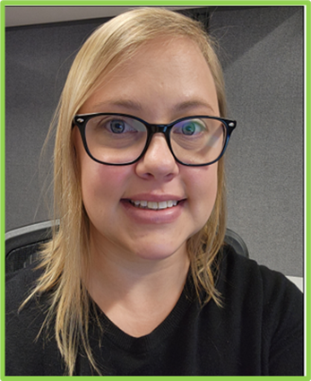
Early Learning Council Staffer
Taylor Seal
Duties:
ELC Executive Committee
ELC Full Committee
Supports all Committee Staffers
Worked in the field of Early Childhood Education for 10 years
Pursuing a Masters in Early Childhood
Previously worked at the Child Development Lab at Heartland Community College with birth – age 3

Slide 9
Role of Committee Staffers
Set up platform for committee meetings
Email meeting notices and minutes to committee members
Distribute committee agenda determined by the Committee Co-Chairs to all committee members
Take minutes (notes) at the meeting and submit to committee co-chairs for review and approval
Assist co-chairs with developing power point slides for committee meetings if applicable and manage slides during the meeting
During meeting take role count votes as required
Ensure meeting information is posted on the identified website

Slide 10
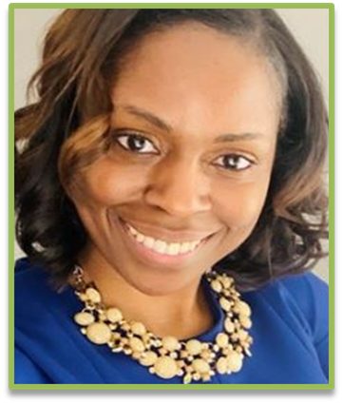
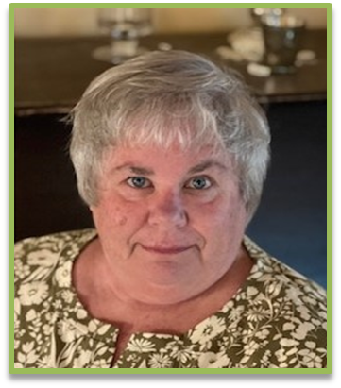
ELC Committee Staffers
Quality & Workforce Mary Kestel
Family Advisory Committee (FAC)
Jillian Davis
Community Equity & Access
Ann Erikson

Slide 11
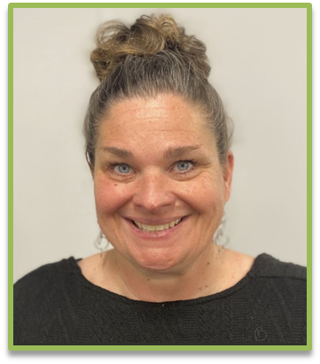
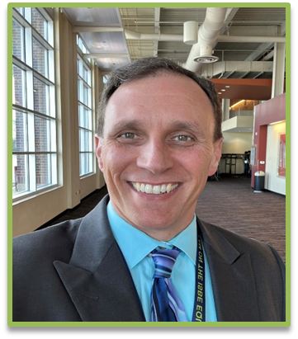
ELC Committee Staffers
Integration and Alignment Nicole Craft
Health & Home Visiting Penny Smith
Research, Evaluation, & Data
Jason Bednar

Slide 12
Questions

